Slide 1
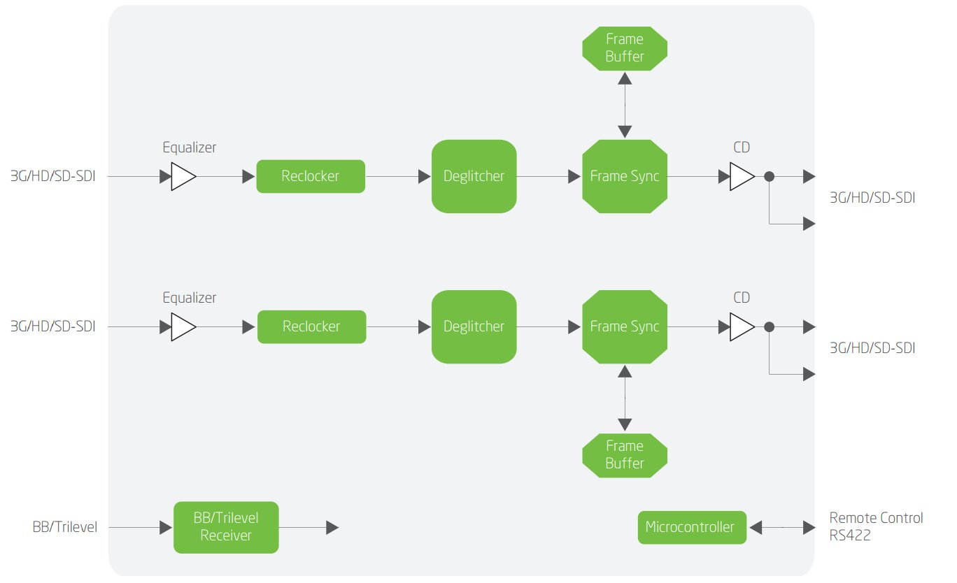
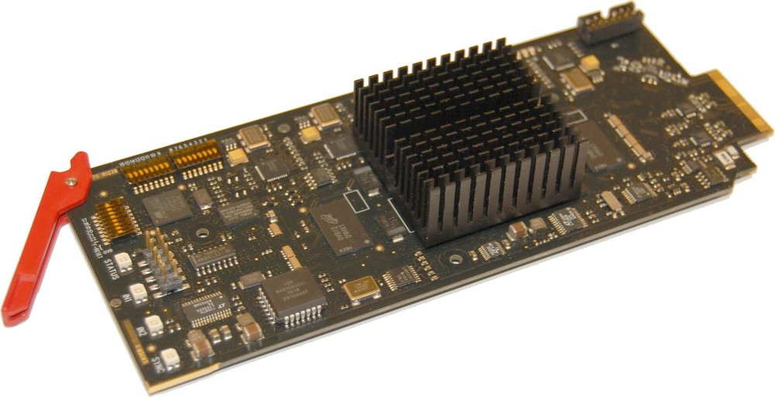
FLASHLINK FRS-3G-DUAL
Applications/ markets
Studio infrastructure
Video sync applications
Key features
SD/HD/3G-SDI support (level A only)
Dual frame synchronizer
Up to 8 frames delay per channel
Deglitcher ensures error free output

Slide 2
FRS-3G-DUAL benefits
Cost savings thru high density
Future compliant with 3G-SDI support
Flexibility thru multi-format support on same boards

